Slide 1

Chhattisgarh Swami Vivekanand Technical University University Teaching Department Department of Computer Science and Engineering
Presented By
Sneha Jha
Roll No. 19
Branch: Data science
Minor Project Presentation
On
Advanced Stock Price Forecasting Using a Hybrid Model of Numerical and Textual Analysis
Guided by :-
Mr. Ramakant Ganjeshwar
Assistant Professor
Madhurima Rawat
Roll No. 42
Branch: Data science
Geetanshu Dev Meshram
Roll No. 43
Branch: Data science

Slide 2
Content
Problem Statement & Objective
Literature Review
Research Methodology
Results and Discussions
Future Scope

Slide 3
Problem Statement and Objective
Objective of Stock Price Prediction: The primary objective is to develop a robust predictive system that forecasts stock prices based on historical financial data from 8 different companies - TCS ,Google, Apple , Amazon , Meta ,Netflix , Nvidia and microsoft.
Integration of Numerical and Textual Data: Our challenge lies in creating a hybrid forecasting model that effectively integrates time-series numerical data with insights derived from Natural Language Processing (NLP) of financial news and reports, enhancing the prediction accuracy of stock prices.
Handling Time-Series Data: The project aims to efficiently manage and store extensive time-series datasets through InfluxDB, ensuring optimal performance and scalability in processing historical stock price information and facilitating rapid data retrieval.
Adoption of Advanced Machine Learning Techniques: We are committed to exploring and implementing advanced machine learning algorithms using real time data from different social media bots, to refine our predictive analysis, enabling the system to adapt to market dynamics and improve forecasting reliability.

Slide 4
Literature Review
Research Paper/Source | Description | Accuracy/RMSE score
Advanced Stock Price Forecasting/IET Research | Focuses on developing advanced deep learning models for live stock price predictions, introducing the Fast RNN model (RMSE: 0.02068, time: 3.35 sec). A hybrid model combining Fast RNN, CNN, and Bi-LSTM (RMSE: 0.02181, time: 18.18 sec) significantly outperforms ARIMA and FBProphet (RMSE: 0.796, 0.935). | Fast RNN: RMSE 0.02068 Hybrid model: RMSE 0.02181 ARIMA: RMSE 0.796 FBProphet: RMSE 0.935
Dealing with Nonlinearity in Stock Prices/ MDPI | Evaluates the MVL-SVM model, integrating multi-view learning with SVM for stock price prediction, achieving nearly 88% accuracy, outperforming ARIMA and traditional SVM (accuracies around 70%). MVL-SVM model based on news and daily returns shows average and median accuracies above 0.8767. | Accuracy: nearly 88%
Hybrid Model for Stock Price Prediction/MDPI | Presents a hybrid model combining Prediction Rule Ensembles (PRE) and Deep Neural Network (DNN) techniques. Utilizes moving average indicators over 20, 50, and 200 days, achieving RMSE of 5.60 for ICICI Bank and 6.30 for SBI Bank, with RMSE scores 5% to 7% lower than existing DNN and ANN models. | ICICI Bank: RMSE 5.60<br>SBI Bank: RMSE 6.30

Slide 5
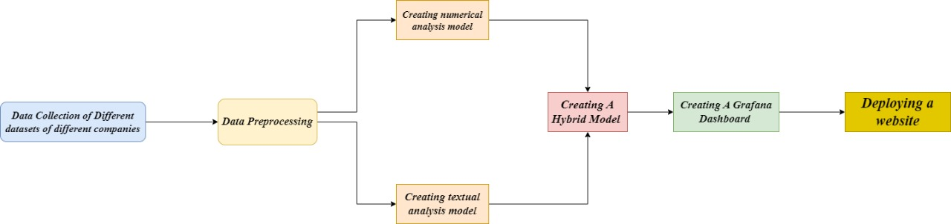
System Flowchart

Slide 6
Methodology : Data Collection
Historical Data: The project required extensive historical stock market data, including stock prices, trading volumes, and other relevant financial metrics. This data was sourced from reputable financial databases such as Yahoo Finance , Kaggle and Macrotrends. It has been gathered from multiple sources to ensure comprehensive coverage.
Economic Indicators: Additional data such as economic indicators, news sentiment, and macroeconomic variables were also collected to enhance the prediction model's accuracy.
Data Storage in InfluxDB: The collected data is stored in InfluxDB, which allows for efficient handling of large-scale time-series data.

Slide 7








Methodology : Exploratory Data Analysis
Company | Data Range | Dataset Shape | Starting Stock Date | Current Stock Date | Starting Stock Price | Current Stock Price
Alphabet Inc. (Google) [GOOG] | 2014-03-27 : 2024-10-17 | (2659, 5) | 2014-03-27 | 2024-10-17 | $27.8542 | $164.51
Amazon.com Inc. [AMZN] | 1997-05-16 : 2024-10-17 | (6901, 5) | 1997-05-16 | 2024-10-17 | $0.0863 | $187.53
Apple Inc. [AAPL] | 1980-12-12 : 2024-10-17 | (11053, 5) | 1980-12-12 | 2024-10-17 | $0.0992 | $232.15
Meta Platforms [META] | 2012-05-18 : 2024-10-17 | (3124, 5) | 2012-05-18 | 2024-10-17 | $38.1174 | $576.93
Microsoft Corp. [MSFT] | 1986-03-13 : 2024-10-17 | (9728, 5) | 1986-03-13 | 2024-10-17 | $0.0603 | $416.72
Netflix Inc. [NFLX] | 2002-05-23 : 2024-10-17 | (5640, 5) | 2002-05-23 | 2024-10-17 | $1.1964 | $687.65
Nvidia Corp. [NVDA] | 1999-01-22 : 2024-10-17 | (6477, 5) | 1999-01-22 | 2024-10-17 | $0.0377 | $136.93
Tata Consultancy Services [TCS] | 2013-11-01 : 2024-10-17 | (2758, 5) | 2013-11-01 | 2024-10-17 | $543.0 | $11.8

Slide 8
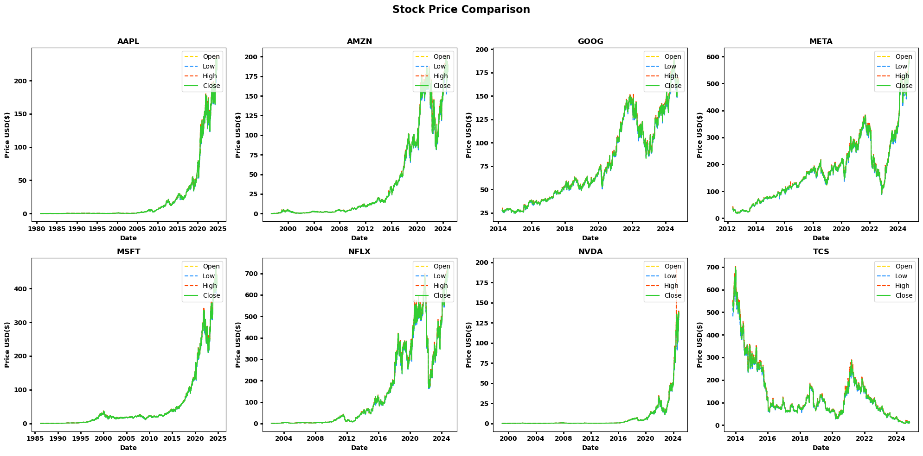
Methodology : Exploratory Data Analysis
The data loading and organization process involved importing stock data into Pandas DataFrames, storing them in a dictionary for easy access, and setting the 'Date' column as the index to enable time-series analysis.
Initial exploration used methods like `info()` and `describe()` for insights into data structure, distribution, and potential issues, while missing values were identified using `isna().sum()`.
Preprocessed datasets were saved as CSV files to ensure reusability.
This systematic approach ensured organized, quality-checked, and time-series-ready data for further analysis.

Slide 9
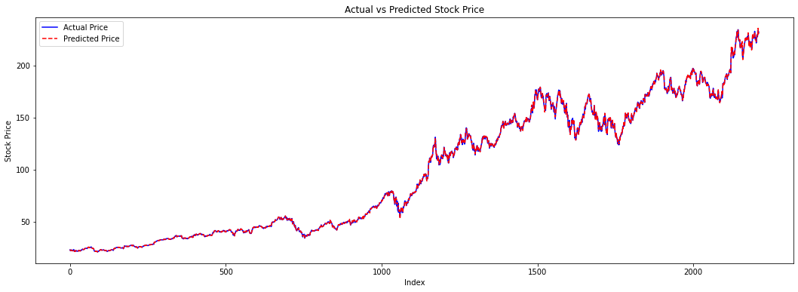
Methodology : Numerical Analysis
It builds a company stock price prediction model using an ensemble approach.
It leverages historical stock data, including opening, high, low, and volume, to predict the closing price.
Four base regression models (Linear, Ridge, Lasso, and Elastic Net) are trained, and their predictions are combined using a Voting Regressor to enhance accuracy.
The model achieved a high R-squared score, indicating strong predictive capabilities, and was saved for future use.
The ensemble method leverages the strengths of individual models to provide robust and potentially more accurate predictions for company's stock closing price.

Slide 10
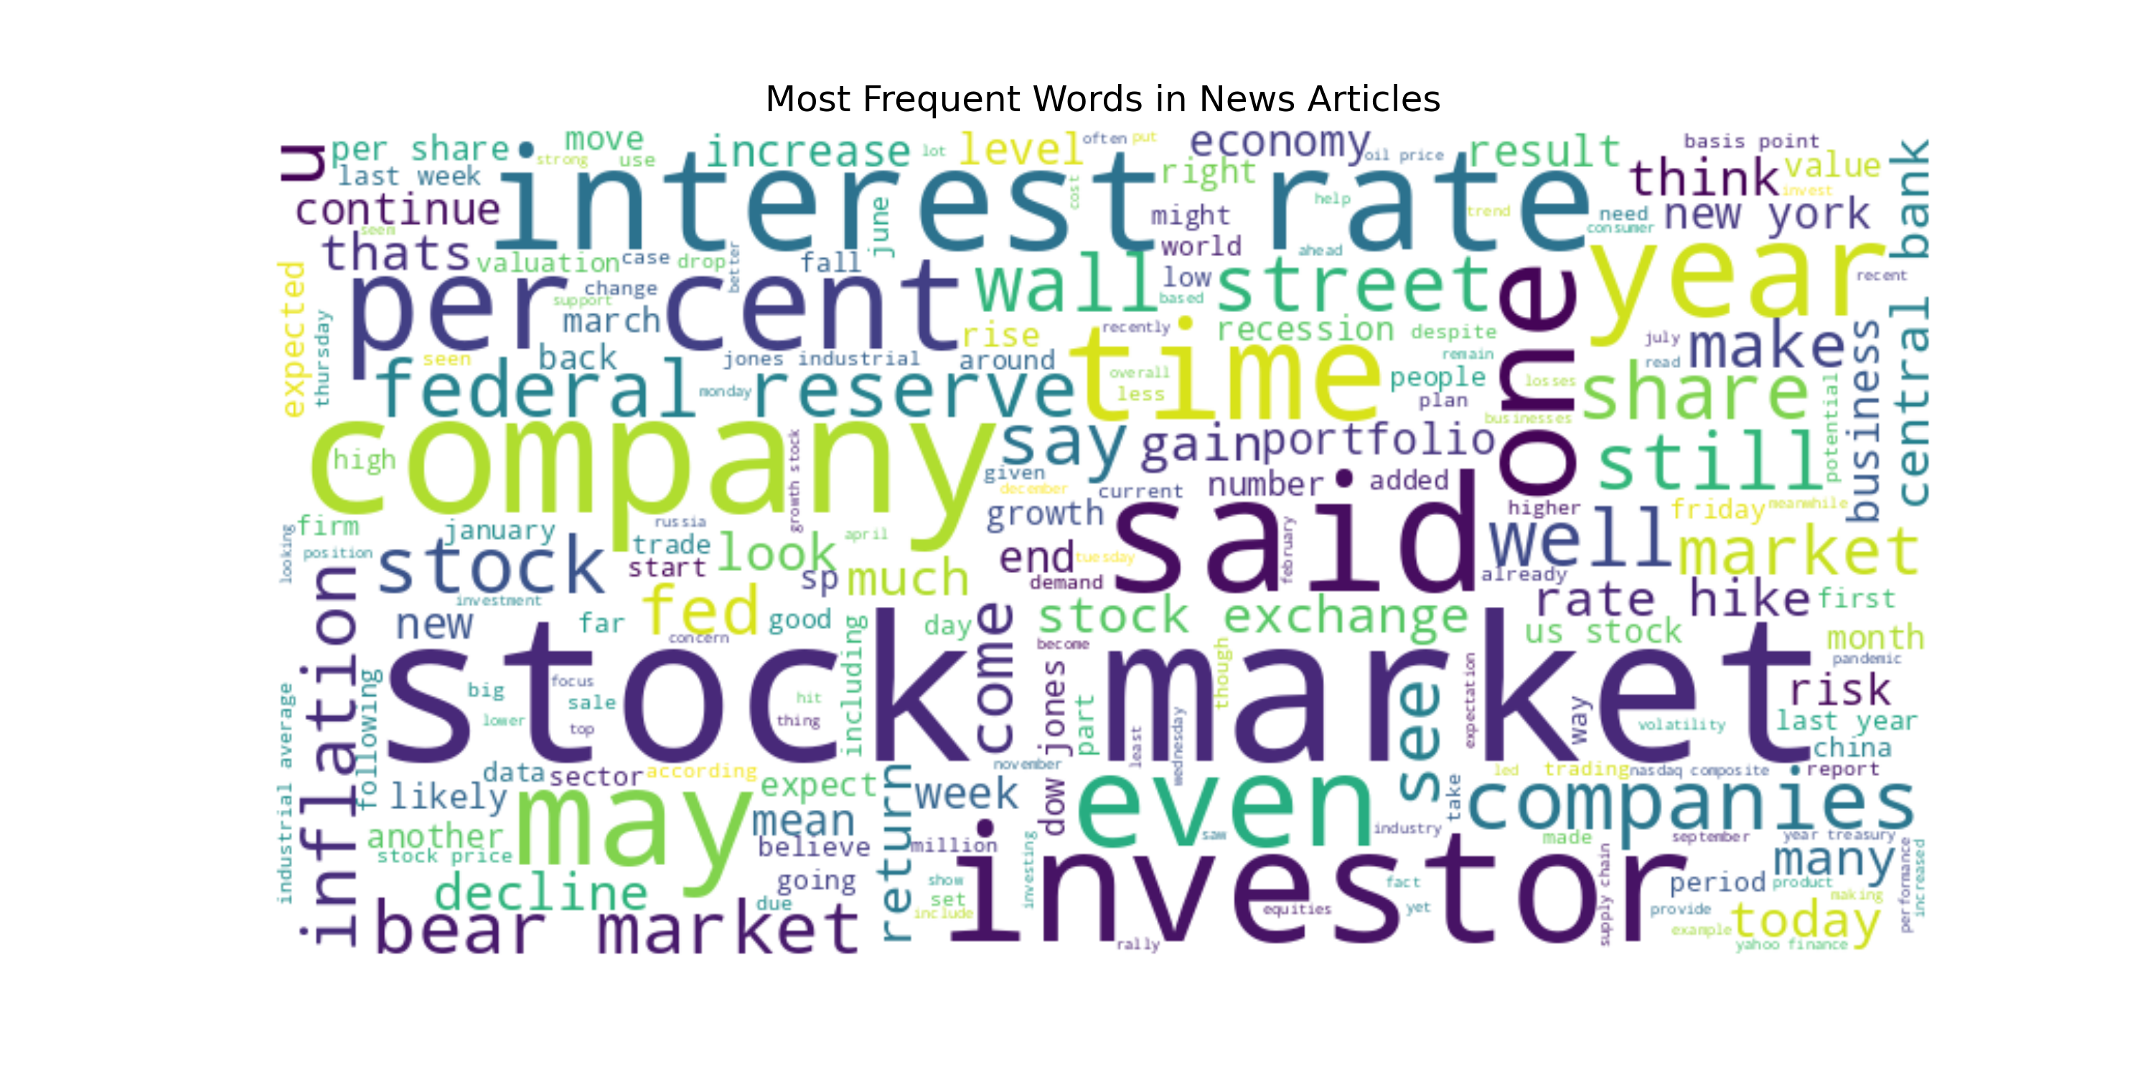
Methodology : Textual Analysis
The code performs sentiment analysis on a news and stock price dataset to predict stock price movements ('up' or 'down').
It starts by importing necessary libraries for data handling, visualization, and machine learning.
It then loads the dataset, performs data cleaning and preprocessing, explores data distributions, and visualizes common words using a word cloud.
The code uses TF-IDF to vectorize text data and splits it into training and testing sets.
Three classification models (Logistic Regression, Naive Bayes, Random Forest) are trained and evaluated using hyperparameter tuning and cross-validation.
Model performance is visualized with confusion matrices and ROC curves. Feature importance is analyzed for Random Forest, and a summary table compares the models' accuracy.
Finally, the best models are saved using both pickle and joblib, and the generated plots and models are saved locally and prepared for download as a zip file.

Slide 11
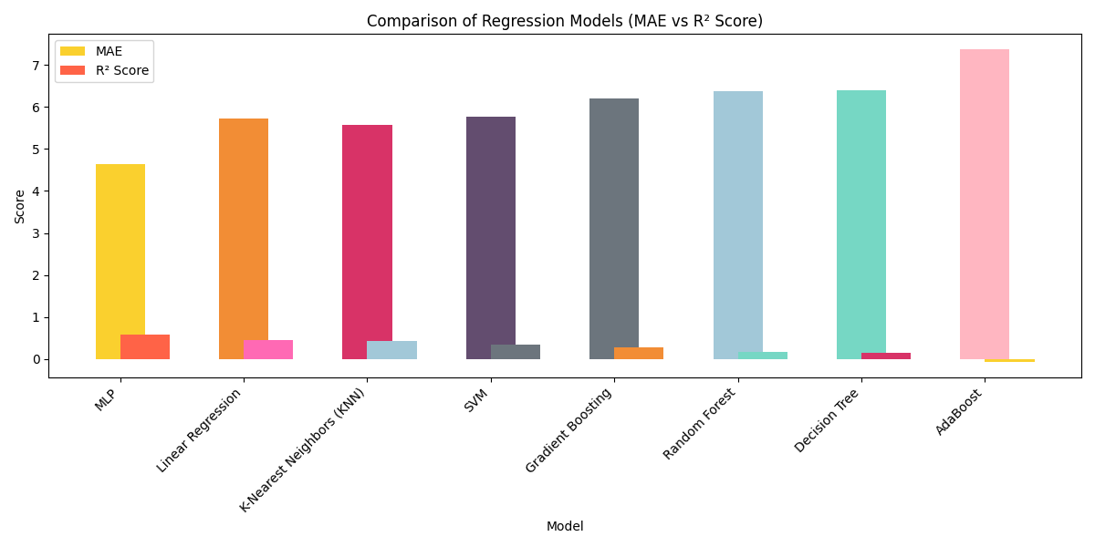
Methodology : Hybrid Model Analysis
It performs stock price prediction using machine learning models incorporating sentiment analysis data.
It preprocesses the dataset by handling missing values, scaling features, and defining targets.
Several models including Linear Regression, Decision Tree, Random Forest, Support Vector Machine, Logistic Regression, Naive Bayes, and K-Nearest Neighbors are trained and evaluated.
Predictions from these models are visualized against actual stock prices over time for both training and testing data to assess their performance and identify the most effective approach for stock price prediction.
The Logistic Regression model predicts stock price movements (up/down), while the Naive Bayes model discretizes prices into categories (low/medium/high).
The code emphasizes reproducibility through seed setting and includes comprehensive explanations for each step.

Slide 12
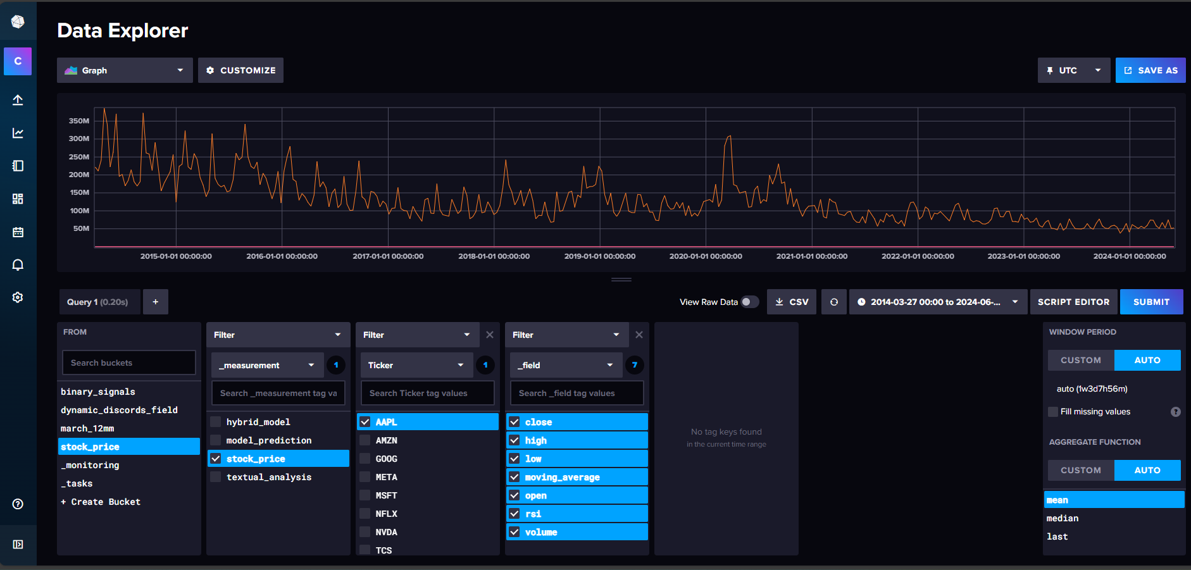
Methodology : InfluxDB Database

Slide 13
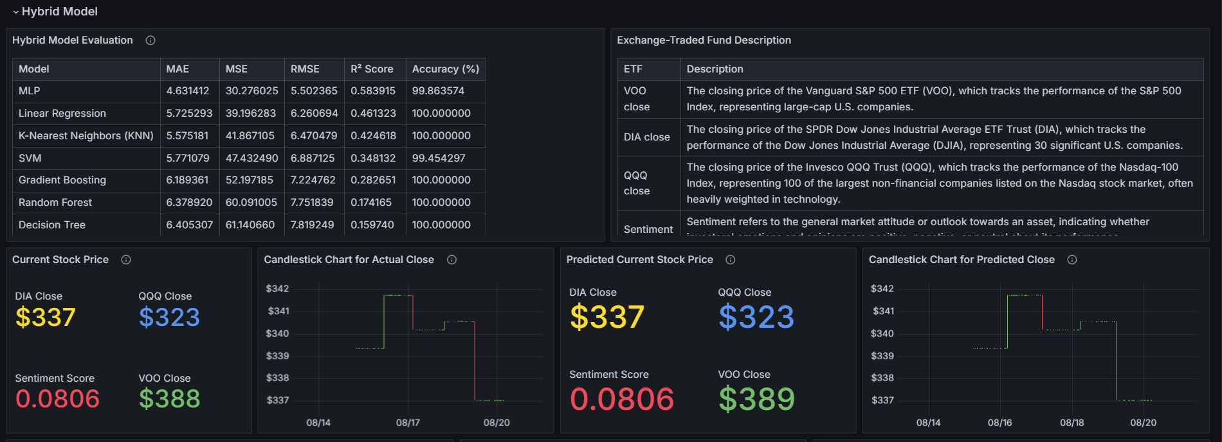
Methodology : Grafana Dashboard

Slide 14
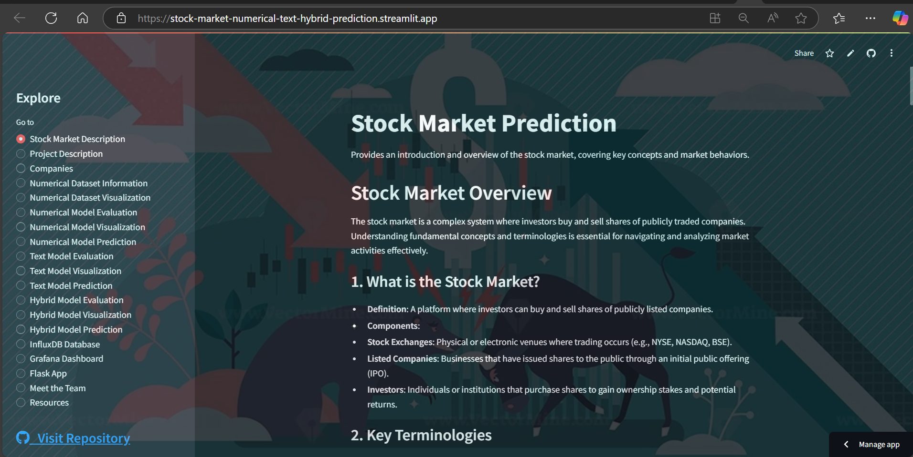
Methodology : Streamlit Deployment

Slide 15
Result and Discussions
Company | R2 Score
AAPL | 0.9997769
AMZN | 0.9984307
GOOG | 0.9987757
META | 0.9995471
MSFT | 0.9997237
NFLX | 0.9987003
NVDA | 0.9975525
TCS | 0.9982187
Table - R2 Score of Ensemble model of all company

Slide 16
Results And Discussion
Model | Accuracy
Logistic Regression | 65.16
Naïve Bayes | 66.72
Random Forest | 98.99
Table : Accuracy of model used in Textual analysis

Slide 17
Result and Discussions
Deployment Links:
GitHub Link: https://github.com/madhurimarawat/Stock-Market-Prediction
Streamlit App: https://stock-market-numerical-text-hybrid-prediction.streamlit.app/

Slide 18
Conclusion
1.The ensemble regression model accurately predicted closing prices for all companies, with R² scores exceeding 0.997 across the board.
2.Random Forest achieved exceptional accuracy in classifying stock news sentiment, further enhancing prediction reliability.
3.The hybrid model provided a comprehensive solution, demonstrating the importance of integrating diverse data sources for robust stock market predictions.
These findings emphasize the potential of hybrid models in financial forecasting and pave the way for future advancements in predictive analytics.

Slide 19
Future Scope of Project
The Advanced Stock Price Forecasting Using a Hybrid Model of Numerical and Textual Analysis project has built a dashboard of hybrid model that integrates numerical stock data and textual analysis from financial news.
The further scope includes:
Including social media bots sentiment analysis like reddit bot , tweepy and telethon APIs.
To include more real time data such as latest data of gold , United States , petroleum etc .
To automate the system so that it updates data on it’s own.

Slide 20
References
Research Papers:
Yadav, K., Yadav, M., & Saini, S. (2021). Stock values predictions using deep learning based hybrid models. CAAI Transactions on Intelligence Technology, 6(3), 266-277. https://doi.org/10.1049/cit2.12052
Long, W., Gao, J., Bai, K., & others. (2024). A hybrid model for stock price prediction based on multi-view heterogeneous data. Financial Innovation, 10, 48. https://doi.org/10.1186/s40854-023-00519-w
Srivinay, Manujakshi, B. C., Kabadi, M. G., & Naik, N. (2022). A hybrid stock price prediction model based on PRE and deep neural network. Data, 7(5), 51. https://doi.org/10.3390/data7050051
For understanding stock market :
1. 40 key Stock Trading Terms for Beginners
2. Basics of Stock Market Volume I
3. Stock Market Zerodha

Slide 21
Thank you

